Slide 1


Jonathan Duncan
12/31/2024

Slide 2

Outline
Executive Summary
Introduction
Methodology
Results
Conclusion
Appendix

Slide 3
Executive Summary
The following methodologies were used to analyze data:
Data Collection using REST API from SpaceX databases along data scraping and normalization
Exploratory Data Analysis (EDA), including data wrangling data visualization and interactive visual analytics
Machine Learning Prediction.
Summary of all results
Used EDA to identify which features are the best to predict success
Machine Learning Prediction showed the best model to predict which characteristics are important to drive this opportunity by the best way, using collected data.

Slide 4
Introduction
SpaceX is the most successful company in the current commercial space age and this is mostly due to their ability to re-use the first stage of their launches
The Goal of this project is to understand the factors that lead to the successful landing of their 1st stage in order to determine how best to replicate those successes

Slide 5

Section 1

Slide 6
Methodology
Executive Summary
Data collection methodology:
REST API calls to SpaceX databases
Performed data wrangling
Data was normalized, filtered and collected into a pandas dataframe
Performed exploratory data analysis (EDA) using visualization and SQL
Performed interactive visual analytics using Folium and Plotly Dash
Performed predictive analysis using classification models
Built, tuned, evaluated classification models

Slide 7
Data Collection
Data sets were collected using REST API calls to the following sources using web scraping techniques
Space X API (https://api.spacexdata.com/v4/rockets/
Wikipedia (https://en.wikipedia.org/wiki/List_of_Falcon/_9/_and_Falcon_Heavy_launches )

Slide 8
Data Collection – SpaceX API
Data was collected using REST API calls to publicly available SpaceX databases.
GitHub link for the completed SpaceX API calls notebook
Used reqeusts.get() to collect data
Filtered data to limit data to Falcon 9 launches
Used mean() to replace missing values

Slide 9
Data Collection - Scraping
Collected launch data from Wikipedia using web-scraping techniques
GitHub link for the completed web scraping notebook
Used requests.get() to collect data then created BeautifulSoup object from data
Collected relevant column names from HTML table data
Created DataFrame by parsing Launch HTML tables

Slide 10
Data Wrangling
Performed Exploratory Data Analysis (EDA) to find patterns in the data and determine the label for training supervised models
GitHub link for the completed data wrangling notebook
Calculated the number of launches per site
Calculated the number of orbits
Calculated the mission outcomes of each orbit
Created outcome label: Success = 1, Fail = 0

Slide 11
EDA with Data Visualization
Used scatter plots to show the relationships between the following
Flight Number and Launch Site
Payload Mass and Launch Site
FlightNumber and Orbit type
Payload Mass and Orbit type
Used Bar chart to show success rate of each orbit type
Used line chart to Visualize the launch success yearly trend
GitHub link of completed EDA with data visualization notebook

Slide 12
EDA with SQL
Summary of the SQL queries performed
Names of the unique launch sites in the space mission
Top 5 launch sites whose name begin with the string 'CCA’
Total payload mass carried by boosters launched by NASA (CRS)
Average payload mass carried by booster version F9 v1.1
Date when the first successful landing outcome in ground pad was achieved
Names of the boosters which have success in drone ship and have payload mass between 4000 and 6000 kg
Total number of successful and failure mission outcomes
Names of the booster versions which have carried the maximum payload mass
Failed landing outcomes in drone ship, their booster versions, and launch site names for in year 2015
Rank of the count of landing outcomes (such as Failure (drone ship) or Success (ground pad)) between the date 2010-06-04 and 2017-03-20.
GitHub link of completed EDA with SQL notebook

Slide 13
Build an Interactive Map with Folium
Added Markers of all Launch Sites:
Marker with Circle, Popup Label and Text Label of NASA Johnson Space Center using its latitude and longitude coordinates as a start location.
Markers with Circle, Popup Label and Text Label of all Launch Sites using their latitude and longitude coordinates to show their geographical locations and proximity to Equator and coasts.
Added Colored Markers of the launch outcomes for each Launch Site:
Colored Markers of success (Green) and failed (Red) launches using Marker Cluster to identify which launch sites have relatively high success rates.
Added Distances between a Launch Site to its proximities:
Colored Lines to show distances between the Launch Site KSC LC-39A (as an example) and its proximities like Railway, Highway, Coastline and Closest City.Summarize what map objects such as markers, circles, lines, etc. you created and added to a folium map
GitHub link of completed interactive map with Folium map

Slide 14
Build a Dashboard with Plotly Dash
The following charts and plots were used to visualize the data
Pie chart to show percentages of launches by launch site
Scatter plot showing the payload range by launch site
These charts and plots were chosen to better show the impact of launch site and payload range on the successful landing of the mission
GitHub link of completed Plotly Dash lab

Slide 15
Predictive Analysis (Classification)
Standardized the data, split it into training data and test data, found the best parameters and classification methods for predicting outcomes using the following models
SVM
Classification Trees
Logistic Regression
K Nearest Neighbors
GitHub link to completed predictive analysis lab
Standardized and slpit data into train and test sets
Tested each model using best parameters
Compared methods using confusion matrix

Slide 16
Results
Exploratory data analysis results
The KSC LC-39A site has the highest number of successful launches and highest success rate
The payload range with the highest launch success rate was 2000 – 4000 KG
The payload range with the lowest launch success rate was 6000 – 8000 KG
The FT Booster version had the highest launch success rate
The number of successful landing outcomes increased over time
Link to screenshot 1 of interactive dashboard
Link to screenshot 2 of interactive dashboard

Slide 17

Section 2

Slide 18
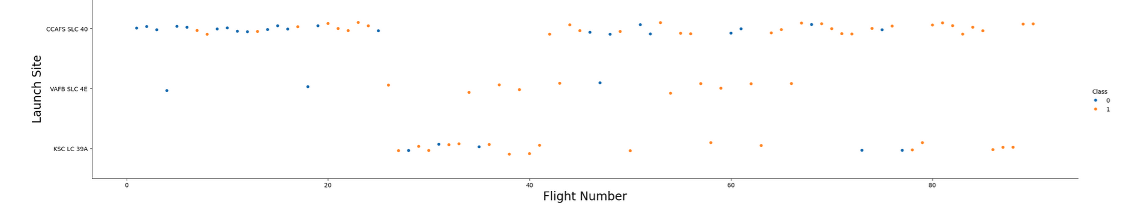
Flight Number vs. Launch Site
Scatter plot of Flight Number vs. Launch Site
This plot shows that the majority of launches occurred at the CCAF5 SLC 40 site and that the success rate improved as more launches occurred

Slide 19
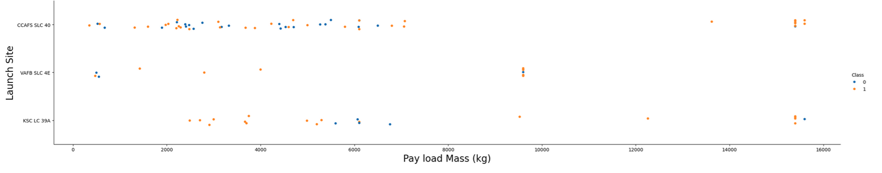
Payload vs. Launch Site
Scatter plot of Payload vs. Launch Site
Launches with payloads of over 9500 KG have a very high success rate
The heaviest payload launches occurred at the CCAFS SLC 40 and KSC LC 39A sites

Slide 20
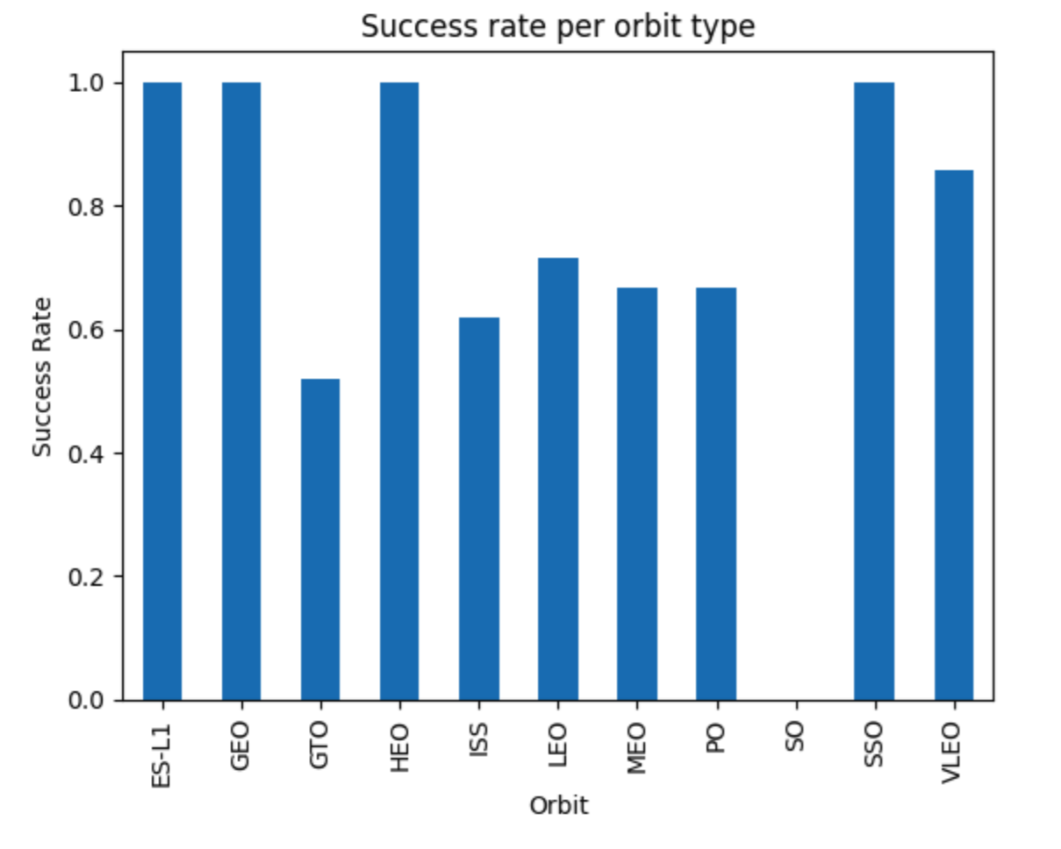
Success Rate vs. Orbit Type
Bar chart showing the success rate of each orbit type
The ES-L1, GEO, HEO and SSO Orbits had the highest success rate.
The SO and GTO orbits had the lowest success rates

Slide 21
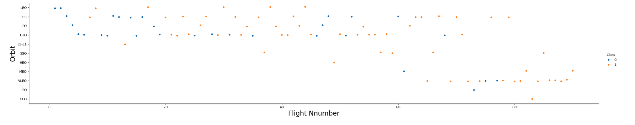
Flight Number vs. Orbit Type
Scatter point of Flight number vs. Orbit type
For most orbits the success rate has improved as the flight number increased
the VLEO orbit has become the most frequent orbit since the Flight Number has surpassed 60 flights

Slide 22
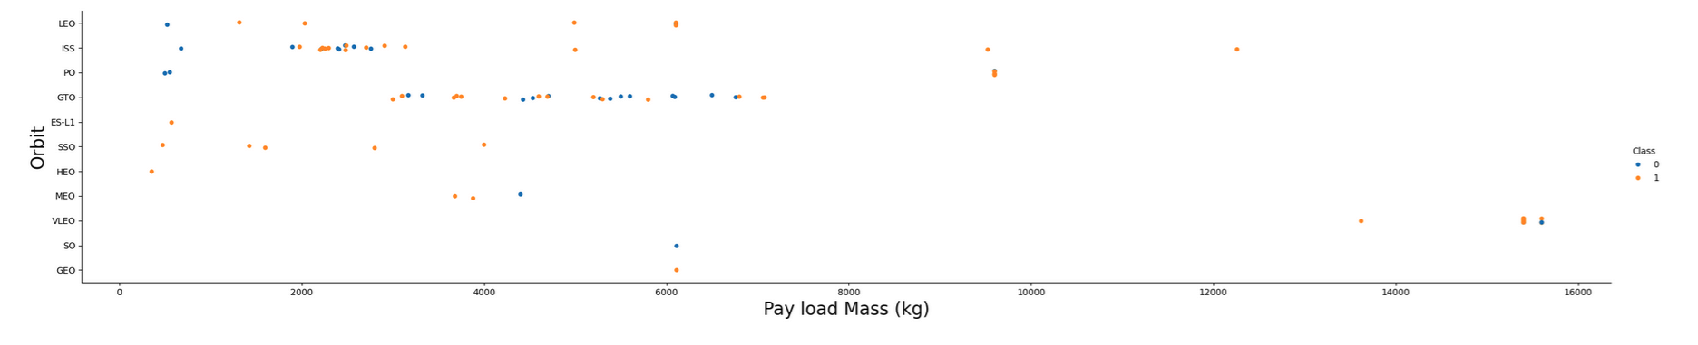
Payload vs. Orbit Type
Scatter point of payload vs. orbit type
For most obits the success rate improved as the Payload Mass increased except for the GTO Orbit that doesn't appear to have a relationship between success rate and payload.

Slide 23
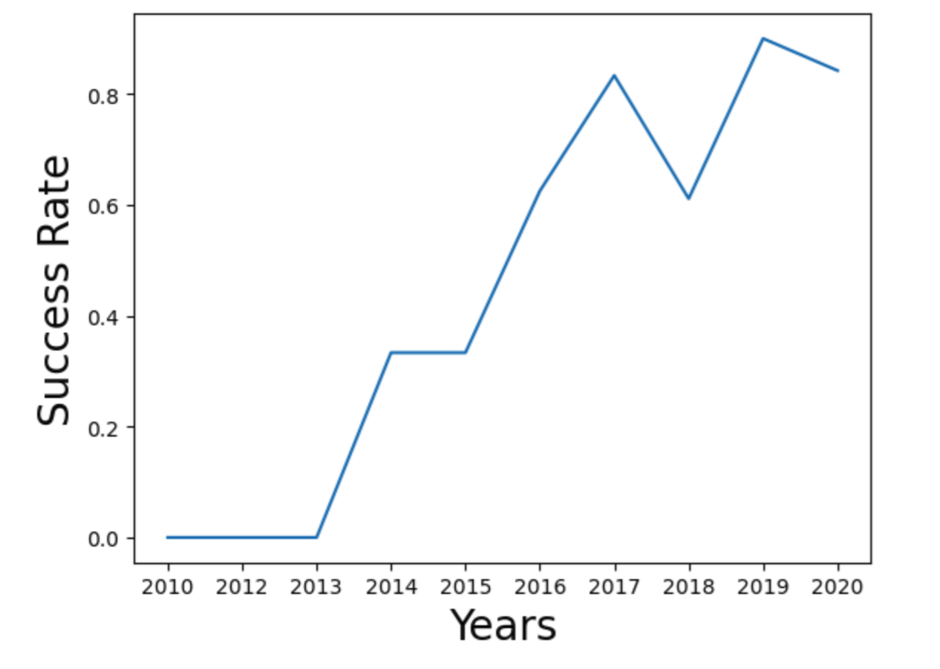
Launch Success Yearly Trend
Line chart showing yearly average success rate
The chart shows that the success rate has improved over the years.

Slide 24
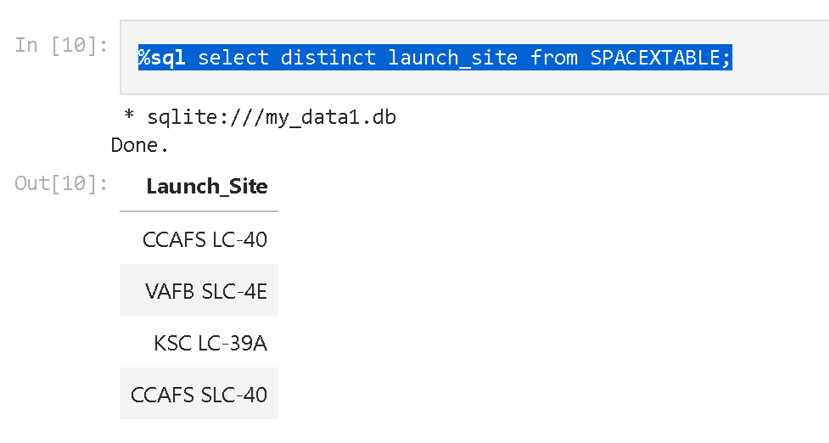
All Launch Site Names
The names of the unique launch sites are shown in image
SQL query used to collect this information - %sql select distinct launch_site from SPACEXTABLE;

Slide 25
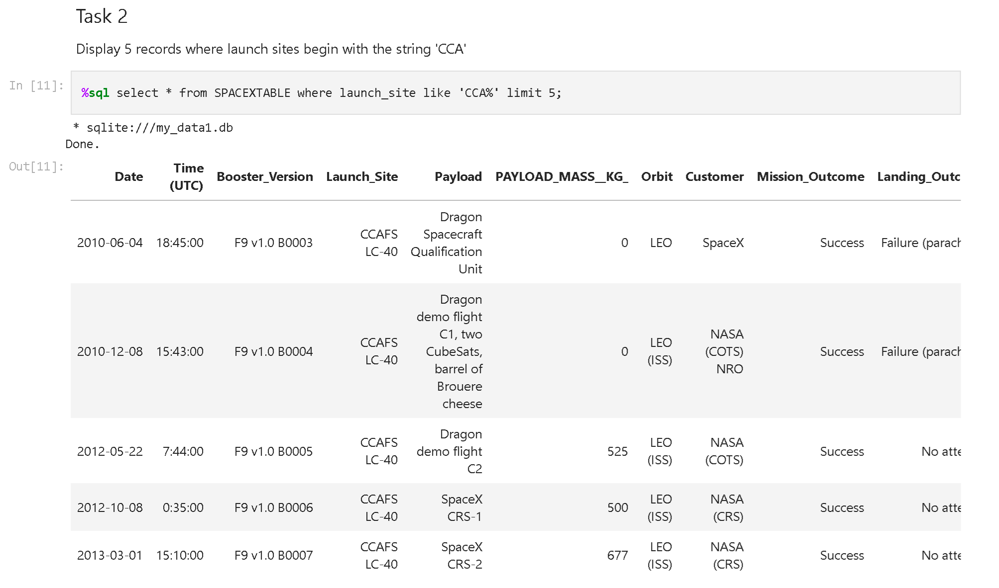
Launch Site Names Begin with 'CCA'
5 records where launch sites begin with `CCA`
SQL Query used to collect this data - %sql select * from SPACEXTABLE where launch_site like 'CCA%' limit 5;

Slide 26
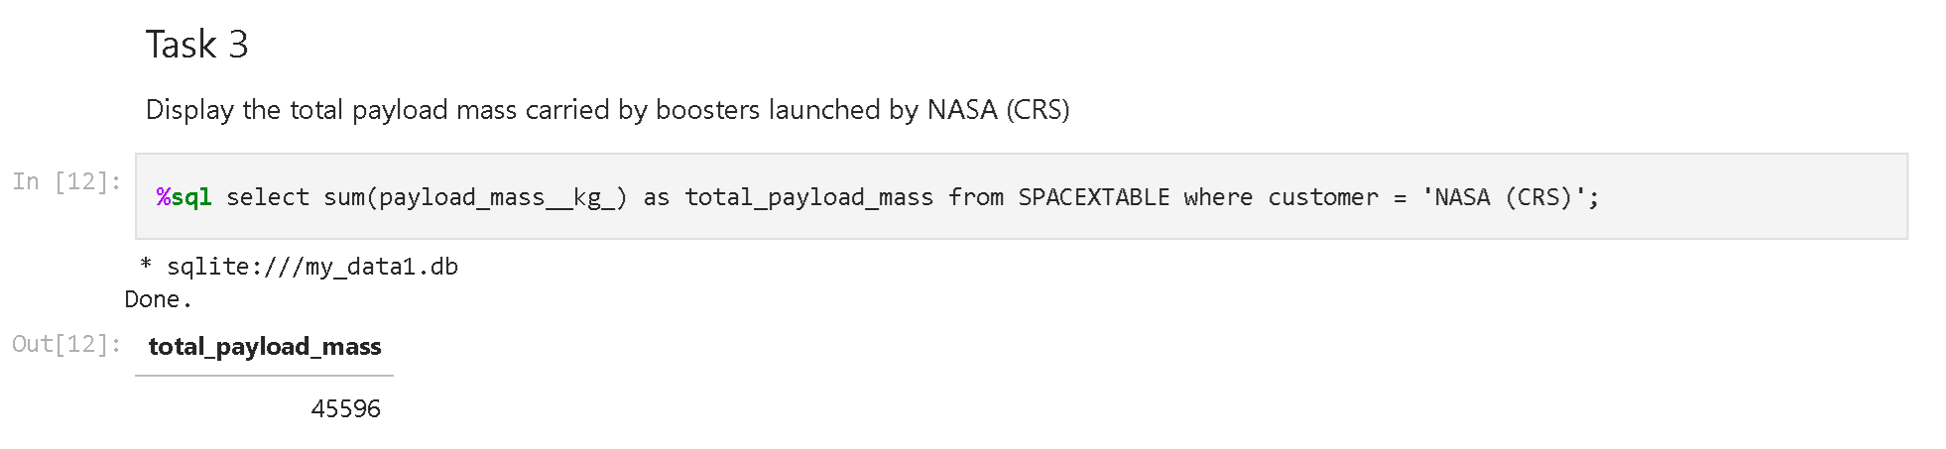
Total Payload Mass
The total payload carried by boosters from NASA
SQL Query used to collect this information - %sql select sum(payload_mass__kg_) as total_payload_mass from SPACEXTABLE where customer = 'NASA (CRS)';

Slide 27
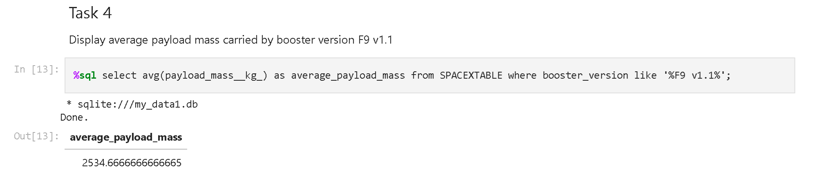
Average Payload Mass by F9 v1.1
The average payload mass carried by booster version F9 v1.1
SQL Query used to collect this information - %sql select avg(payload_mass__kg_) as average_payload_mass from SPACEXTABLE where booster_version like '%F9 v1.1%';

Slide 28
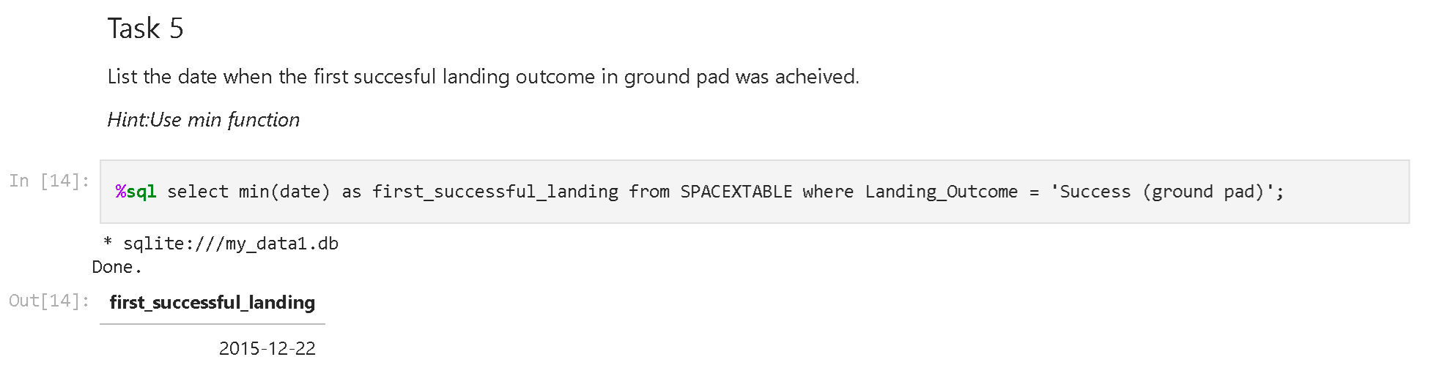
First Successful Ground Landing Date
The Date of the first successful landing outcome on ground pad
SQL Query used to collect this information - %sql select min(date) as first_successful_landing from SPACEXTABLE where Landing_Outcome = 'Success (ground pad)';

Slide 29
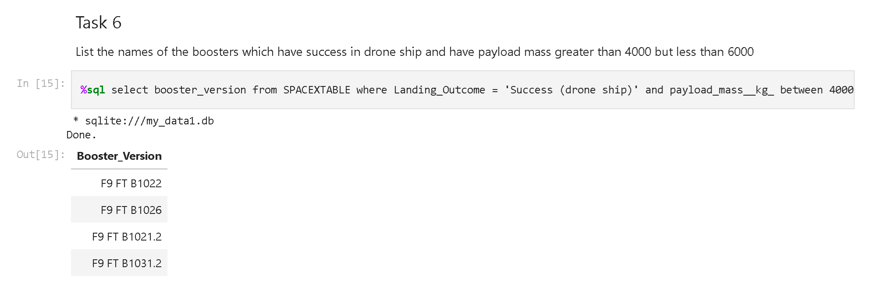
Successful Drone Ship Landing with Payload between 4000 and 6000
The names of boosters which have successfully landed on drone ship and had payload mass greater than 4000 but less than 6000
SQL Query to collect this information - %sql select booster_version from SPACEXTABLE where Landing_Outcome = 'Success (drone ship)' and payload_mass__kg_ between 4000 and 6000;

Slide 30
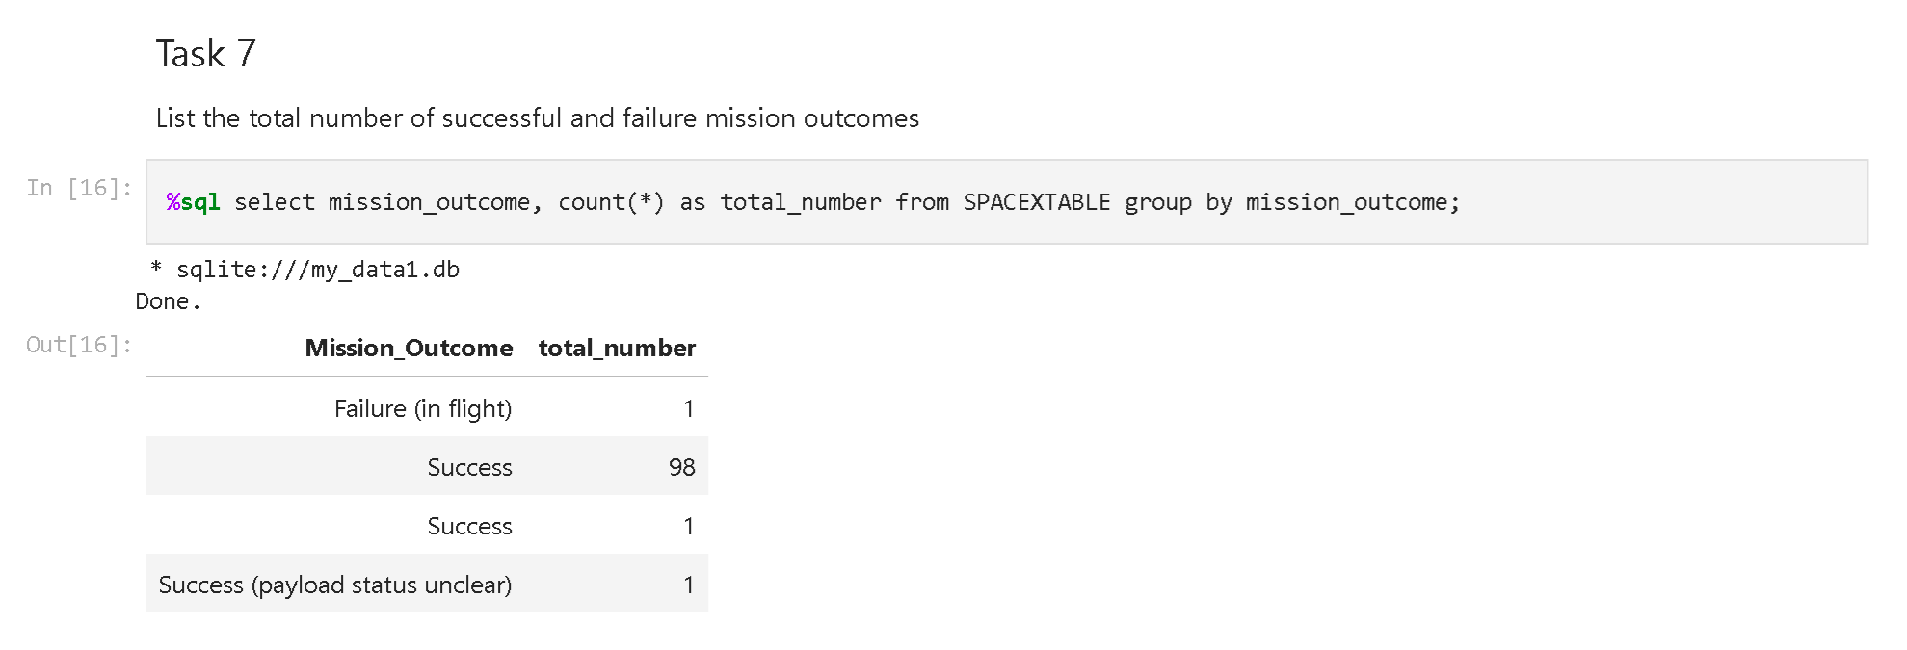
Total Number of Successful and Failure Mission Outcomes
The total number of successful and failure mission outcomes
SQL Query used to collect this information - %sql select mission_outcome, count(*) as total_number from SPACEXTABLE group by mission_outcome;

Slide 31
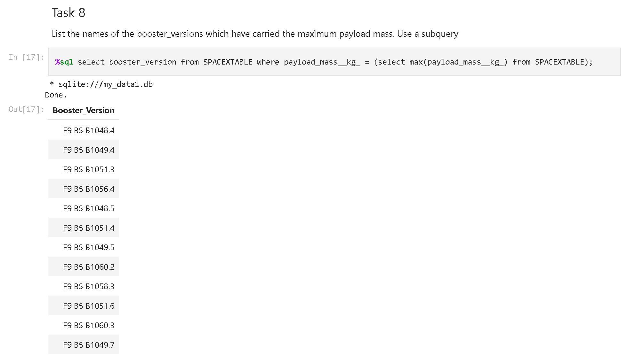
Boosters Carried Maximum Payload
The names of the booster which have carried the maximum payload mass
SQL Query used to collect this information - %sql select booster_version from SPACEXTABLE where payload_mass__kg_ = (select max(payload_mass__kg_) from SPACEXTABLE);

Slide 32
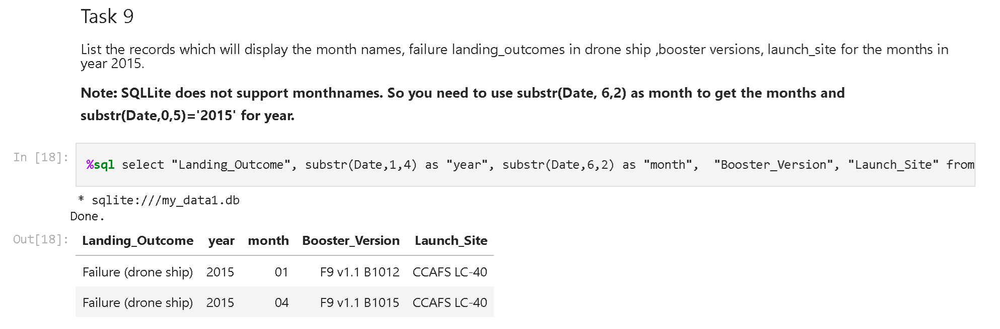
2015 Launch Records
The failed landing_outcomes in drone ship, their booster versions, and launch site names for in year 2015
SQL Query used to collect this data - %sql select "Landing_Outcome", substr(Date,1,4) as "year", substr(Date,6,2) as "month", "Booster_Version", "Launch_Site" from SPACE

Slide 33
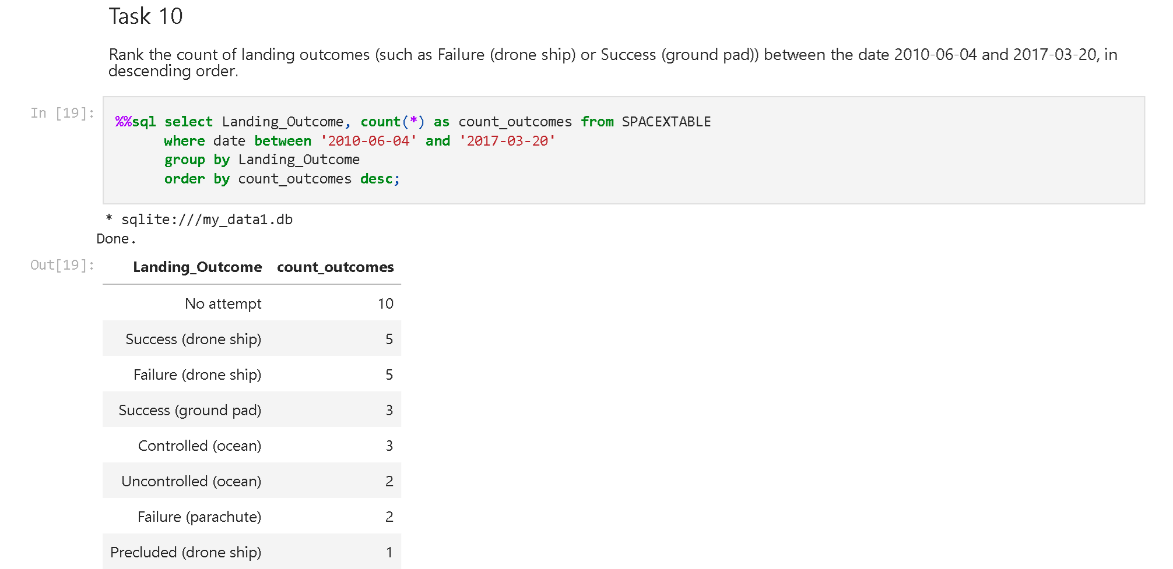
Rank Landing Outcomes Between 2010-06-04 and 2017-03-20
Rank the count of landing outcomes (such as Failure (drone ship) or Success (ground pad)) between the date 2010-06-04 and 2017-03-20, in descending order

Slide 34

Section 3

Slide 35

Launch Sites
Launch Sites located on each coast within close proximity to roads and railroads.

Slide 36

Launch Outcome at CCAFS SLC-40 site
Launch site outcomes at CCAFS SLC-40 site. Red markers indicate failures and green markers indicate successes

Slide 37
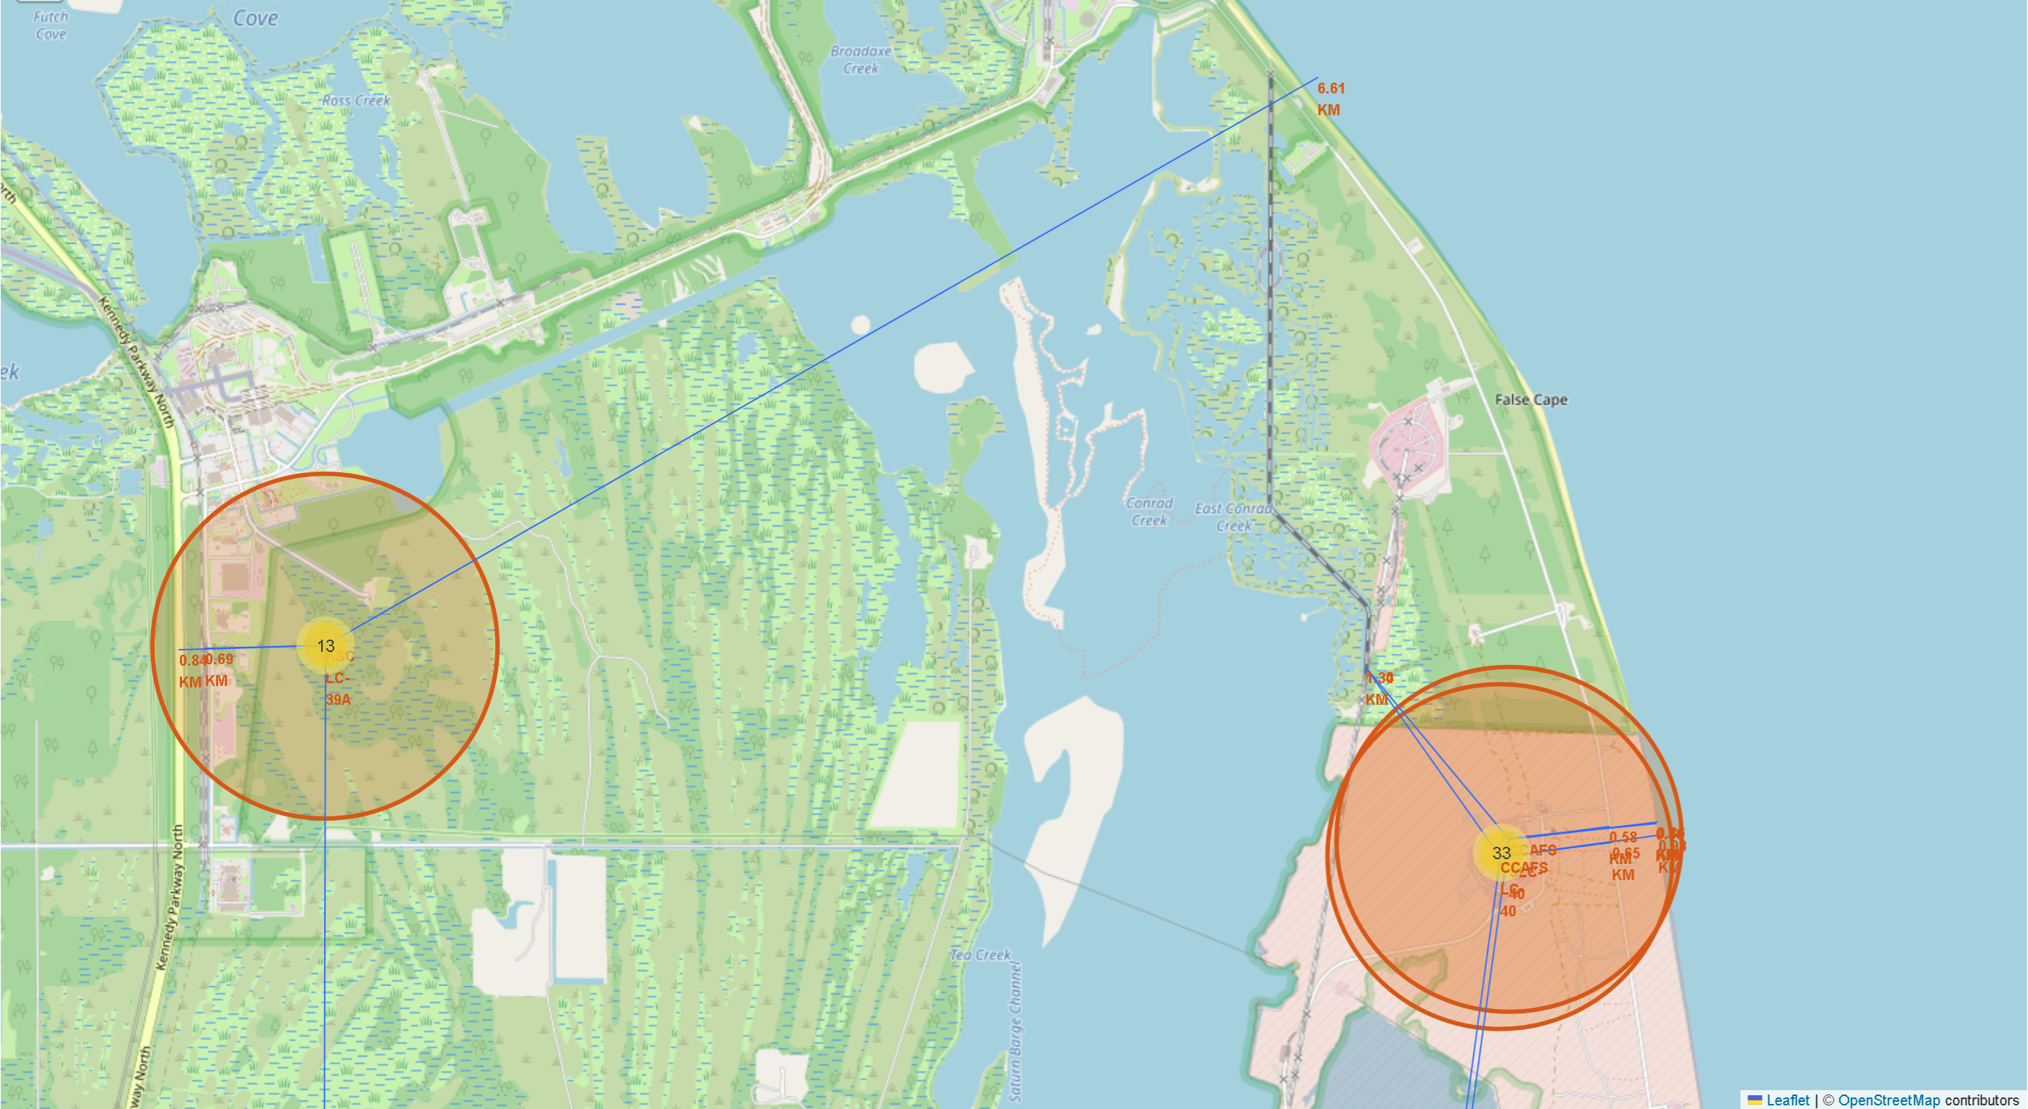
Launch Site Proximities
The launch sites on the east coast are close to the coastlines, railroads and roads

Slide 38

Section 4

Slide 39
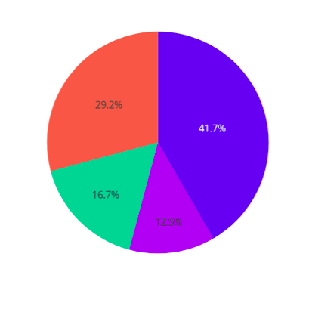
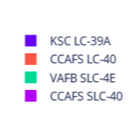
Launch Success rate by Site
The KSC LC-39A site has the highest success rate with the CCAFS LC-40 site having the second highest rate

Slide 40
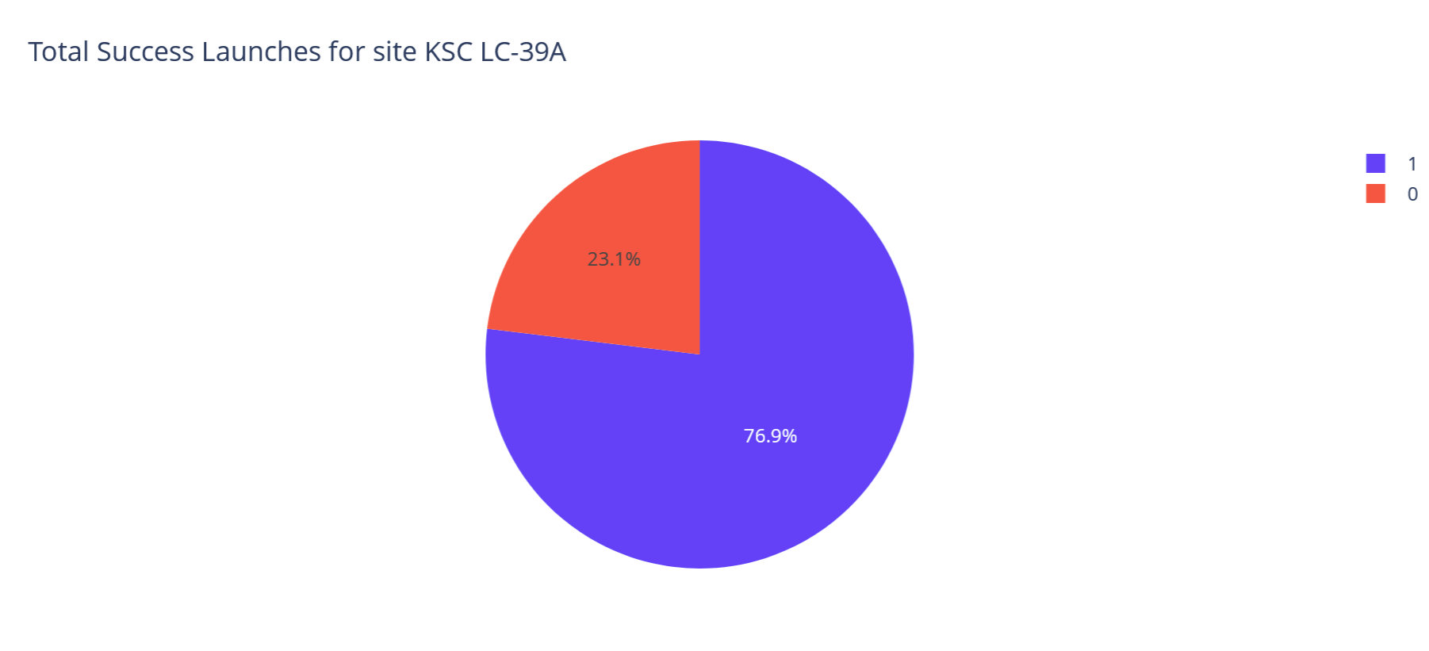
Launch Success at the KSC LC-39A Site
The KSC LC-39A site has the highest succes rate at 76.9%

Slide 41
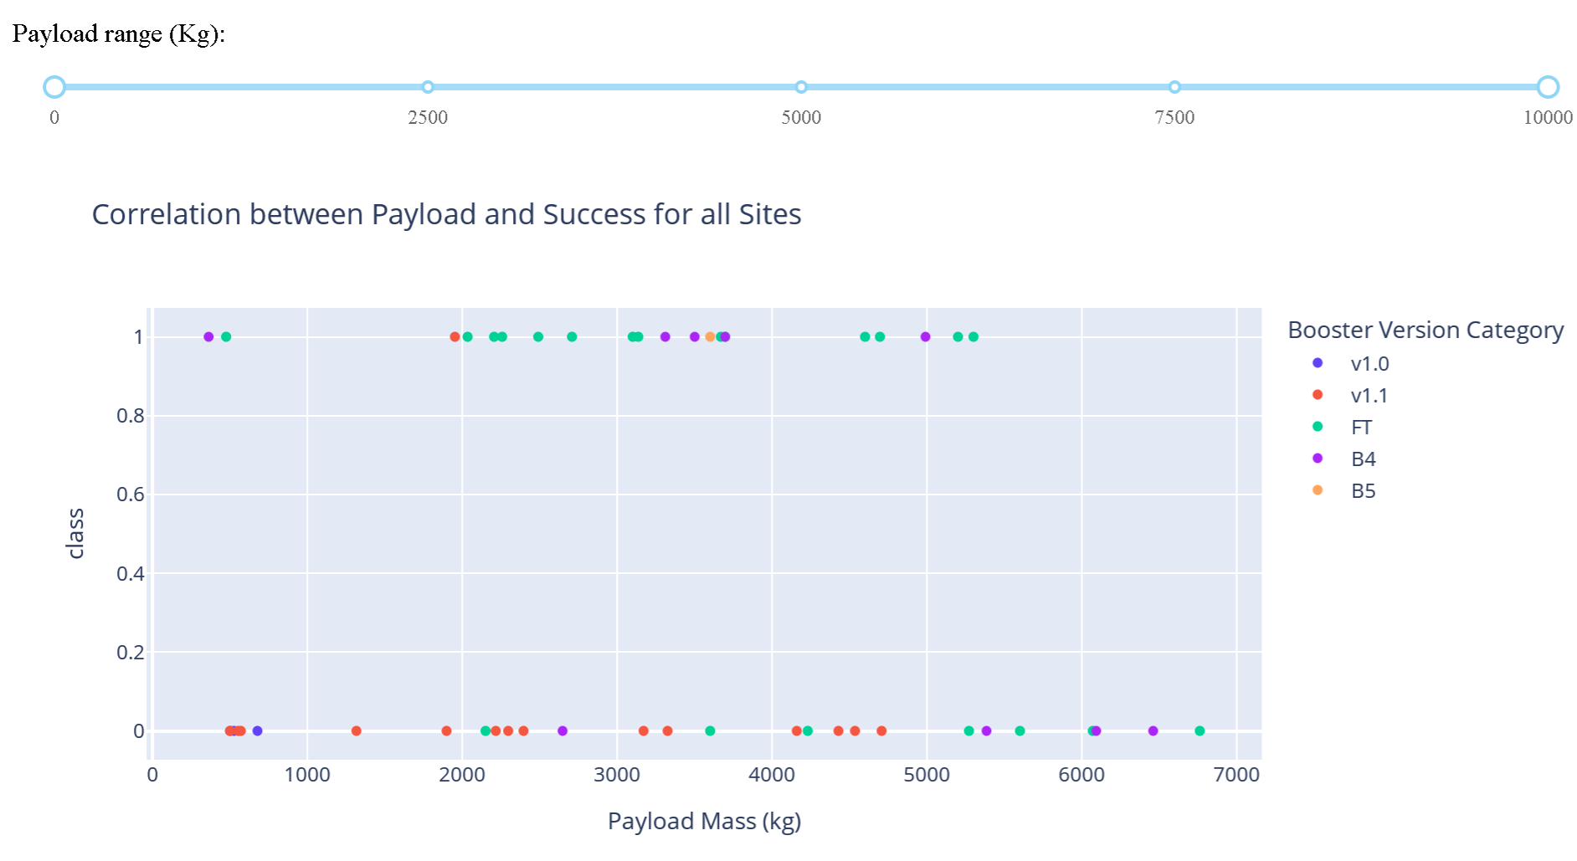
Payload vs Success rate for all Booster Versions
Payloads of less than 6000 KG and the FT Booster has been the most successful combination

Slide 42
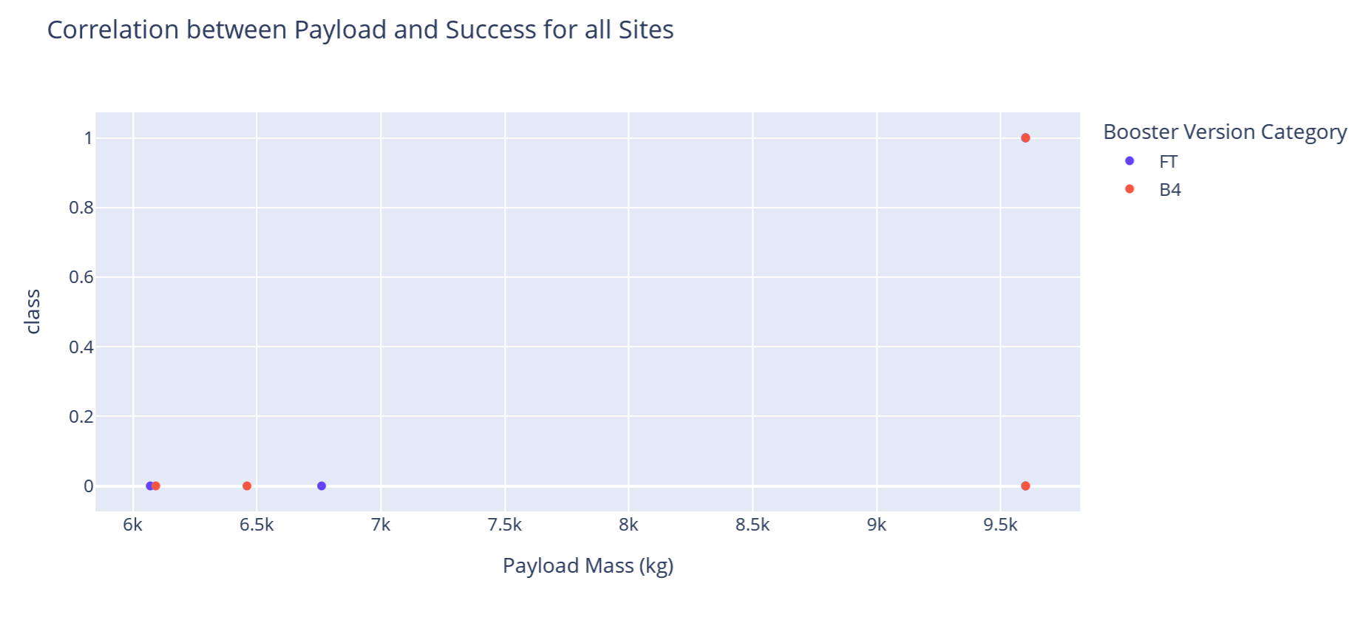
Payload vs Success rate for all Booster Versions
Payloads of over 6000KG have been the least successful missions

Slide 43

Section 5

Slide 44
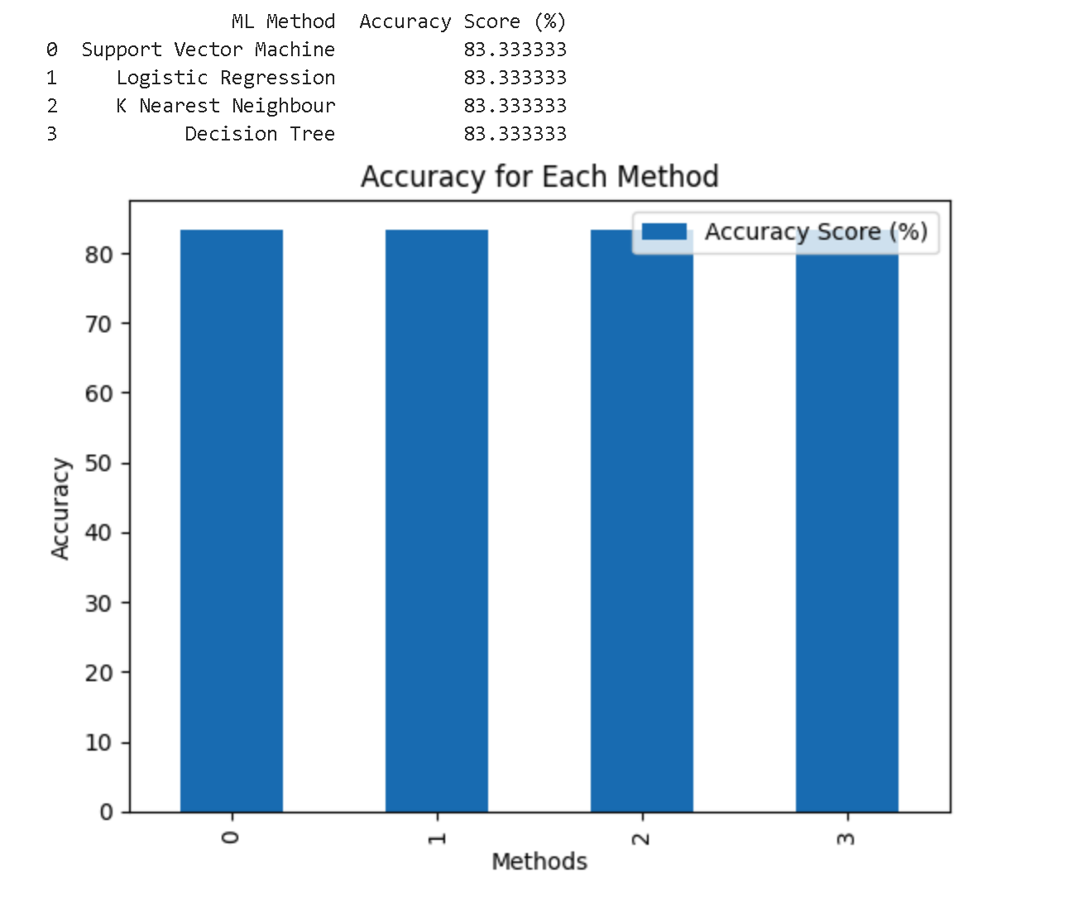
Classification Accuracy
This Bar Chart shows the built model accuracy for all built classification models
All models were found to be 82% accurate.

Slide 45
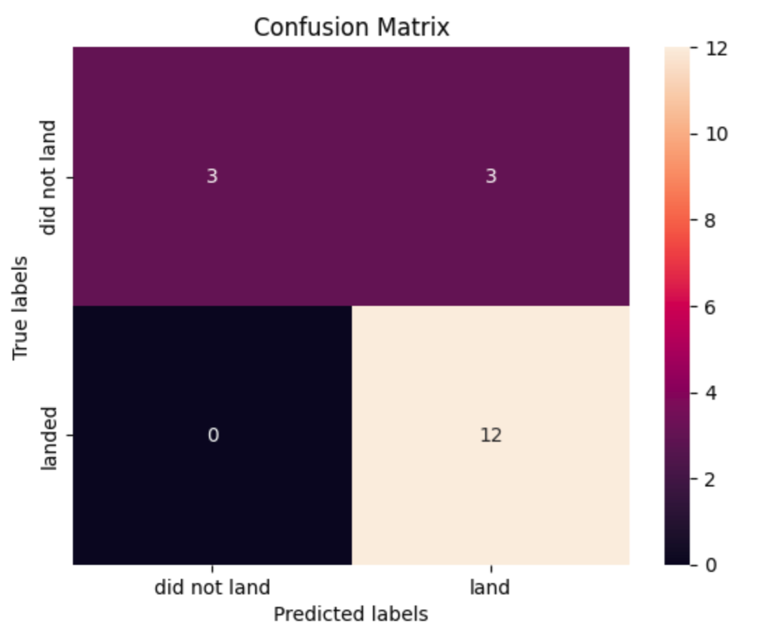
Confusion Matrix
Each model was found to have the same Confusion Matrix as shown below

Slide 46
Conclusions
The KSC LC-39A has the highest success rate of all the different sites.
Missions with payloads less than 6000KG have a higher rate of success
Success rate of launches has increased over time.
Any of the Mchine Learning methods tried can predict the success outcome with an 83% accuracy.

Slide 47
Appendix
GitHub link to all code created for this project - https://github.com/jduncangh/Applied_Data_Science_Capstone.git

Slide 48


